Slide 1
Solid state

Slide 2
Imperfections in solids
The defects are of two types, namely, point defects and line defects.
Point defects are the irregularities or deviations from ideal arrangement around a point or an atom in a crystalline substance.
line defects are the irregularities or deviations from ideal arrangement in entire rows of lattice points. These irregularities are called crystal defects.

Slide 3
Types of Point Defects
stoichiometric defects
(ii) impurity defects and
(iii) non-stoichiometric defects.

Slide 4
Stoichiometric Defects: Point defects that do not disturb the stoichiometry of the solid are called as Stoichiometric Defects. Basically these are of two types, vacancy defects and interstitial defects.
Vacancy Defect: When some of the lattice sites are vacant, the crystal is said to have vacancy defect and it leads to decrease in density of the substance.
(ii) Interstitial Defect: When some constituent particles (atoms or molecules) occupy an interstitial site, the crystal is said to have interstitial defect. increases the density of the substance.

Slide 5
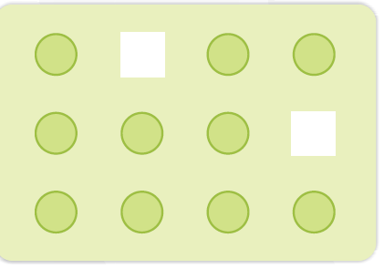
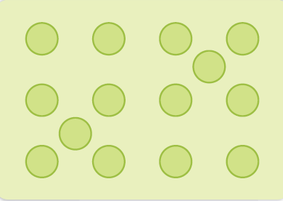
Vacancy defect
Interstitial Defect

Slide 6
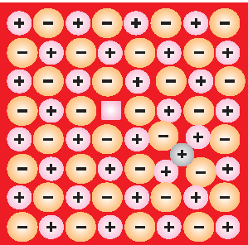
(iii) Frenkel Defect: This defect is shown by ionic solids. The smaller ion (usually cation) is dislocated from its normal site to an interstitial site. It creates a vacancy defect at its original site. It does not change the density of the solid. for example, ZnS, AgCl, AgBr and AgI due to small size of Zn²⁺ and Ag⁺ ions.

Slide 7
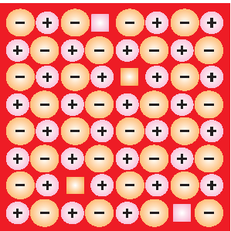
(iv) Schottky Defect: in this type of defect equal no. Of cations and anions will be missing from the crystal lattice. Schottky defect also decreases the density of the substance. For example, NaCl, KCl, CsCl and AgBr. It may be noted that AgBr shows both, Frenkel as well as Schottky defects.

Slide 8
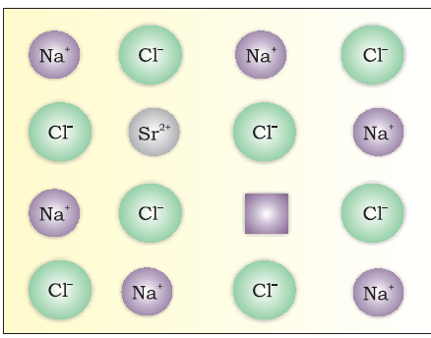
(b) Impurity Defects: In this type of defect cations are replaced by another cation with different charge. For example SrCl₂ . Sr²⁺ occupies the site of one ion and the other site remains vacant. The cationic vacancies thus produced are equal in number to that of Sr²⁺ ions. Another similar example is the solid solution of CdCl₂ and AgCl.

Slide 9
(c) Non-Stoichiometric Defects: Point defects that disturb the stoichiometry of the solid are called as Non-Stoichiometric Defects. These defects are of two types:
(i) metal excess defect and
(ii) metal deficiency defect.

Slide 10
Metal Excess Defect:
(a) Metal excess defect due to anionic vacancies: this type of defect arises when an anion is missing from the normal site and the charge is neutralized by electrons. Eg NaCl As a result the crystal now has an excess of sodium. The anionic sites occupied by unpaired electrons are called F-centres. They impart yellow colour to the crystals of NaCl. Excess of lithium makes LiCl crystal pink and excess of potassium makes KCl crystal violet.

Slide 11
Metal excess defect due to the presence of extra cations at interstitial sites: Zinc oxide on heating it loses oxygen and turns yellow. Now there is excess of zinc in the crystal excess Zn²⁺ ions move to interstitial sites and the electrons to neighbouring interstitial sites.
(ii) Metal Deficiency Defect: many solids are difficult to prepare in the stoichiometric composition and contain less amount of the metal as compared to the stoichiometric proportion. A typical example of this type is FeO. In crystals of FeO some Fe²⁺ cations are missing and the loss of positive charge is made up by the presence of required number of Fe³⁺ ions.

Slide 12
Electrical properties
Conductors: The solids with conductivities ranging between 10⁴ to 10⁷ ohm^{–1}m^{–1} are called conductors.
Insulators:
Semiconductors:

Slide 13
Conduction of Electricity in Metals
Metals conduct electricity in solid as well as molten state.
If valence band is partially filled or it overlaps with a higher energy unoccupied conduction band, then electrons can flow easily under an applied electric field and the metal shows conductivity.
If the gap between filled valence band and the next higher unoccupied band (conduction band) is large, electrons cannot jump to it and such a substance has very small conductivity and it behaves as an insulator

Slide 14
Conduction of Electricity in Semiconductors
In case of semiconductors the energy gap is very small therefore electrons can jump and show some conductivity.
Conductivity in semiconductors increases with increase in temperature.
Conductivity can be increased by adding small amount of impurity. This process of adding impurity to increase the conductivity is called as Doping.

Slide 15
Types of impurities:
Electron rich impurity: When Si and Ge are doped with a group 15 element like P or As, which contains five valence electrons, fifth electron is extra and becomes delocalised. These delocalised electrons increase the conductivity of doped silicon. Here the increase in conductivity is due to the negatively charged electron, hence silicon doped with electron-rich impurity is called n-type semiconductor.

Slide 16
Electron – deficient impurities: When Silicon or germanium are doped with a group 13 element which contains only three valence electrons the place for the fourth valence electron will be missing. This is called electron hole or electron vacancy. This type of semi conductors are called p-type semiconductors.

Slide 17
Magnetic Properties
Pramagnetism: Paramagnetic substances are weakly attracted by a magnetic field. Paramagnetism is due to presence of one or more unpaired electrons which are attracted by the magnetic field.
Diamagnetism: Diamagnetic substances are weakly repelled by a magnetic field. Diamagnetism is shown by those substances in which all the electrons are paired and there are no unpaired electrons.

Slide 18
Ferromagnetism: A few substances which are attracted very strongly by a magnetic field are called ferromagnetic substances.
Antiferromagnetism: Substances like MnO showing antiferromagnetism have domain structure similar to ferromagnetic substance, but their domains are oppositely oriented and cancel out each other's magnetic moment.
Ferrimagnetism: Ferrimagnetism is observed when the magnetic moments of the domains in the substance are aligned in parallel and anti-parallel directions in unequal numbers. These substances also lose ferrimagnetism on heating and become paramagnetic.

